Slide 2
House Hunters
Thomas Clemons: Chairman and CEO
Gi ’Anna Cheairs: CFO and Comptroller
Vineet Duggi: CTO
Timothy Carter: COO

Slide 3
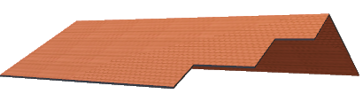
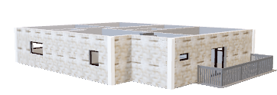
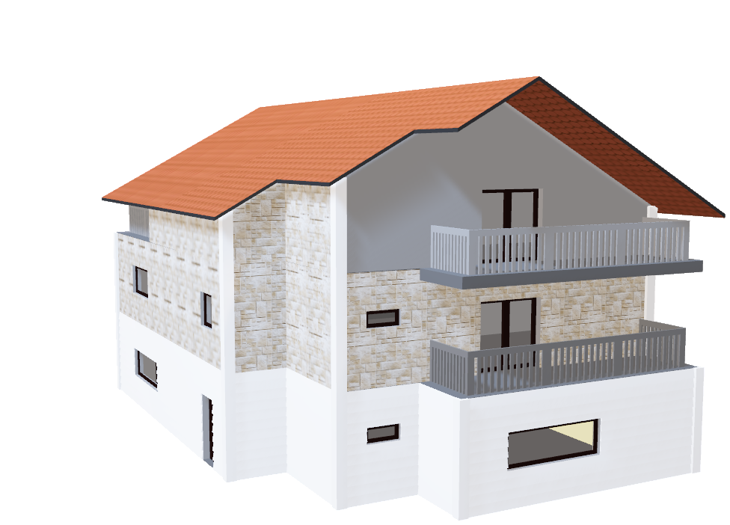
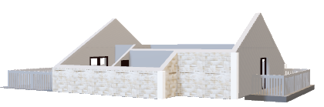
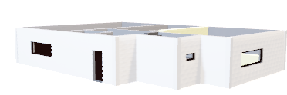
House Hunters Presents: The Ultimate in Modern Home Search
In a world where downtime is more wishful thinking than reality, it’s essential that your home offers true tranquility, space, and comfort.
Introducing the Fit Analysis for living:
House Hunters Evaluation
Designed to make the most efficient choice with your time while searching for your dream or forever home. Whether its natural light, soaring ceilings, 8ft doors, and space enough for the largest of families, this really is an analysis organization where your home search and buying is made simple.

Slide 4
Outline Project Objective/Proposal: The aim of our project is to identify which attributes of this dataset have the biggest effect on the sale price of homes in various neighborhoods of Ames, IA. We’ll examine relationships between various data points and the sale price. We will use this modeling to predict the sale price of homes that we have in our Real Estate portfolio.
Data File
Read in CSV
Reviewed Length
Reviewed Type
Data Preprocessing
Remove/Rename missing Values
Categorical Variables - Label Encoded
Scaled
Split
Statistical Method
Variance Inflation Factor (VIF)
Probability Value (p-value)
Regression Analysis
Linear, Lasso, Random, Gradient Boost, and CatBoost
Fit Regression Model to Data
Coefficient (R-Squared), Evaluate Mean Absolute Error (MAE) and Mean Squared Error (MSE)
Gradient Boost
Cat Boost
Best Model and Validation
CatBoost
Cross Validation

Slide 5
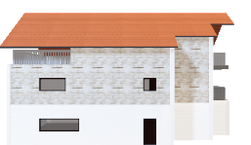
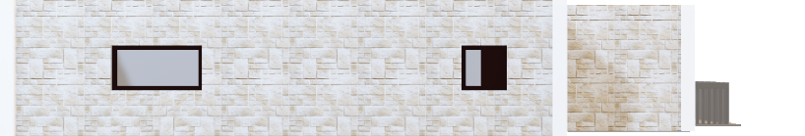
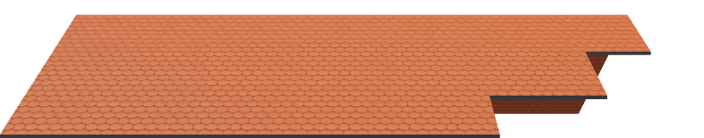

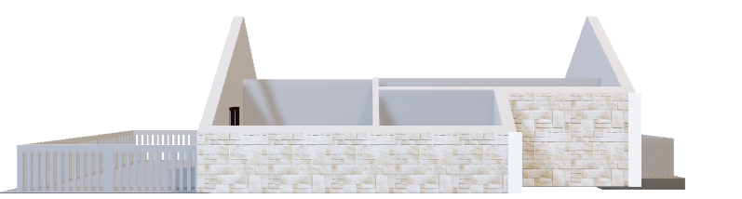
Data Exploration & Clean-up
Missing Values:
Dazzling Roman style roof tiles.
Dropped Nulls and Replaced with “Does not Have”
Categorial Variables:
Natural stone complementing the surrounding environment
Scaled:
Strategic window placement for an aesthetically pleasing exterior
Split:
Whitewashed exterior provides a contemporary, yet classical, finish

Slide 6
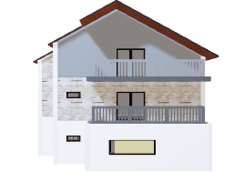
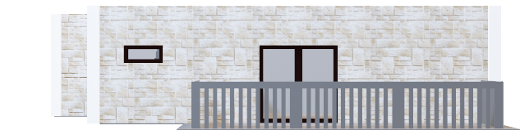


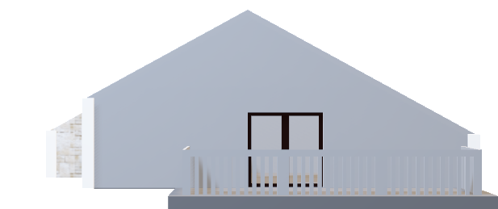
Statistical Method
Variance Inflation Factor:
Terrace Finish & Panaroma Windows
Column Values at 10+ were removed
Probability Value:
Stone Tile and Enclosed Sun Porch
P-Values allowed us to further enhance our data clean-up

Slide 7
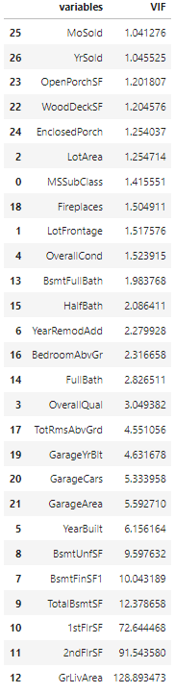
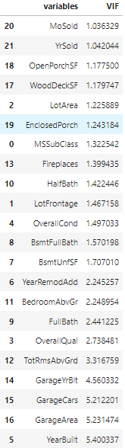
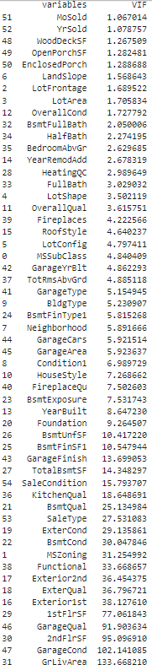
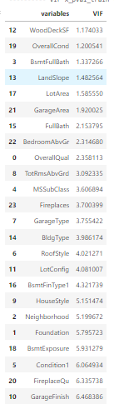
Statistical Method
Initial VIF
Secondary VIF
Variance Inflation Factor:
Terrace Finish & Panaroma Windows
Column Values at 10+ were removed
Probability Value:
Stone Tile and Enclosed Sun Porch
P-Values allowed us to further enhance our data clean-up

Slide 8
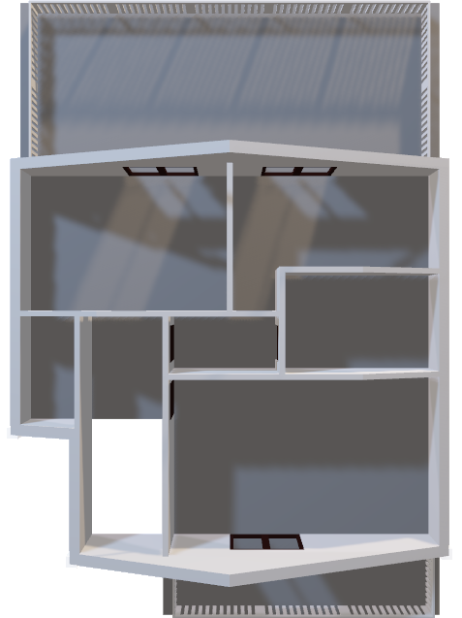
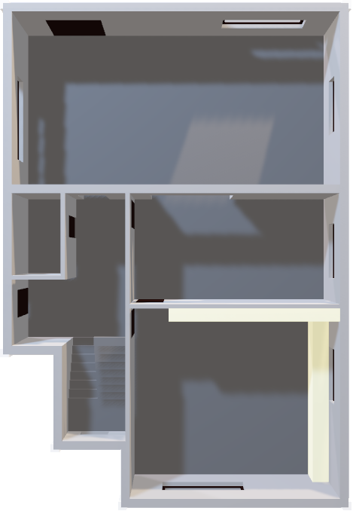
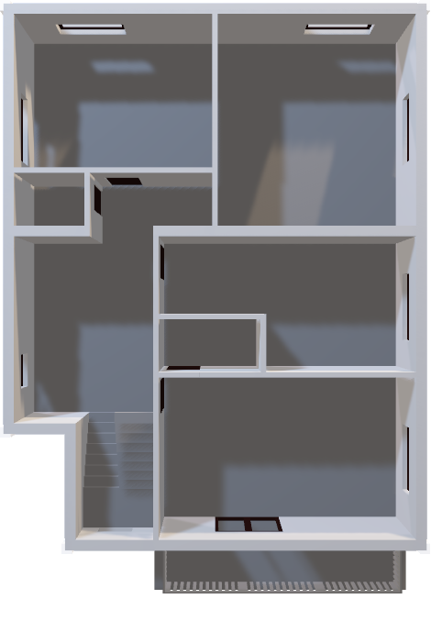
Regression Analysis
Linear
Lasso
Random

Slide 9
Regression Analysis
XGBoost
CatBoost

Slide 10
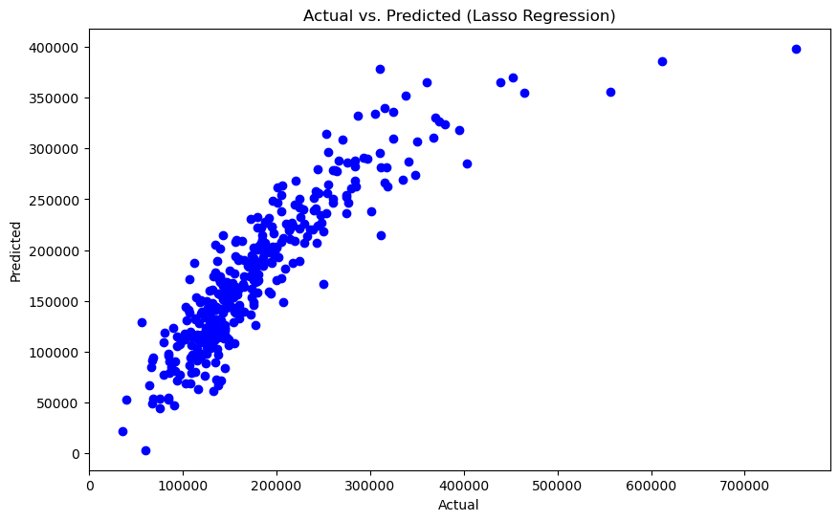
Lasso
The Values Narrative
R-squared: 0.7830943994223807
Mean Absolute Error:
25173.89159828941
Mean Squared Error:
1519490767.2294931
Root Mean Squared Error: 38980.64605967291

Slide 11
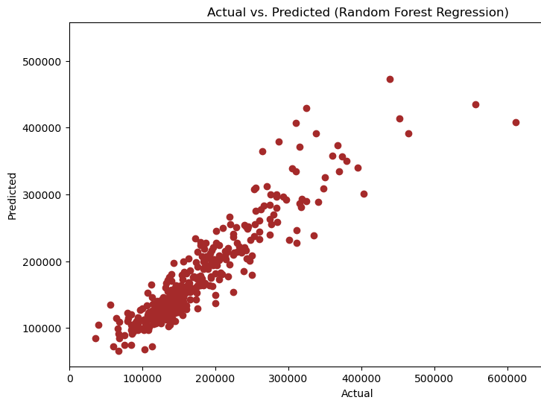
Random Forest
The Values Narrative
R-squared: 0.8536607463238572
Mean Absolute Error:
20753.749406392697
Mean Squared Error:
1025151698.4900634
Root Mean Squared Error: 32017.990231900305

Slide 12
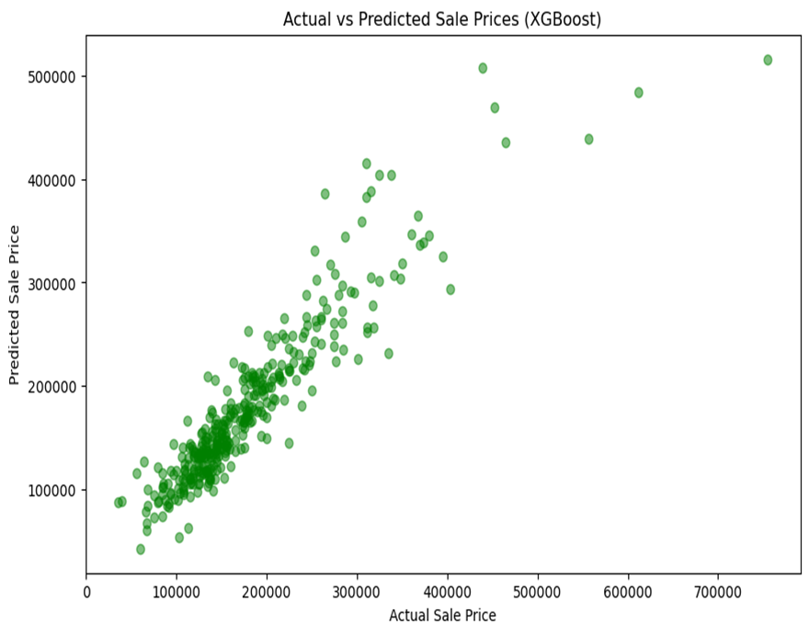
XGBoost
Values Narrative
R-squared: 0.8553621589835805
Mean Absolute Error:
21126.00980308219
Mean Squared Error:
1013232776.9831389
Root Mean Squared Error:
31831.317550223066

Slide 13
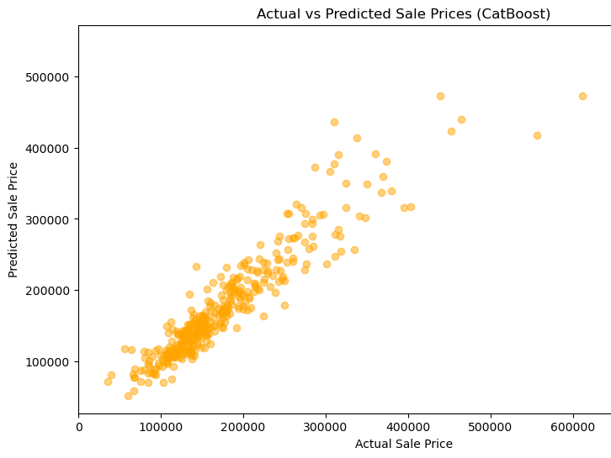
CatBoost
Values Narrative
R-squared: 0.8774344325281175
Mean Absolute Error:
19291.19610825505
Mean Squared Error:
858609679.3158845
Root Mean Squared Error:
29302.04223797182

Slide 14
Regression Conclusion
Lasso R-Squared- 0.7830943994223807
CatBoost in our data file provided the most accurate model.
Lasso as you can see did not meet or fulfill the project requirements.
We wanted to view several models to determine the best fit.
Random R-Squared- 0.8536607463238572
XGBoost R-Squared- 0.8553621589835805
CatBoost R-Squared- 0.8774344325281175

Slide 15
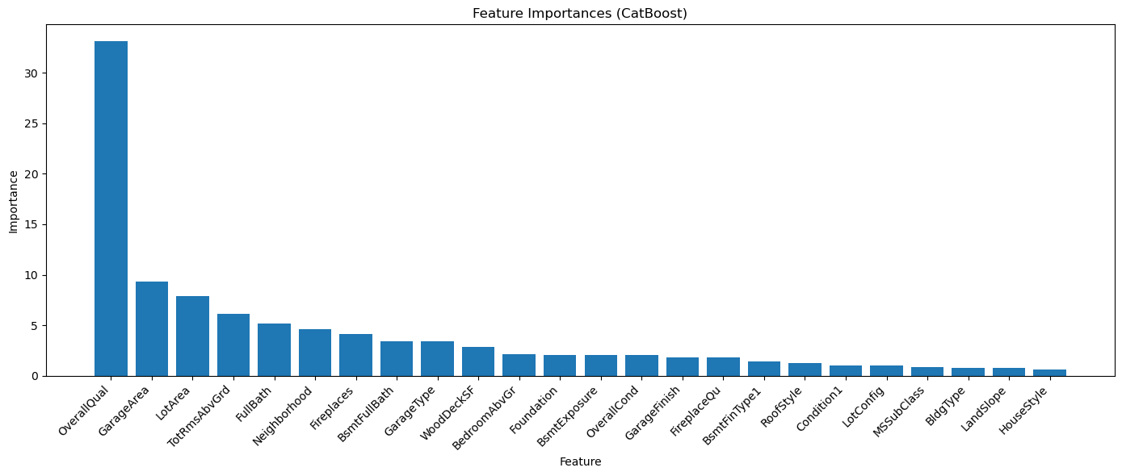
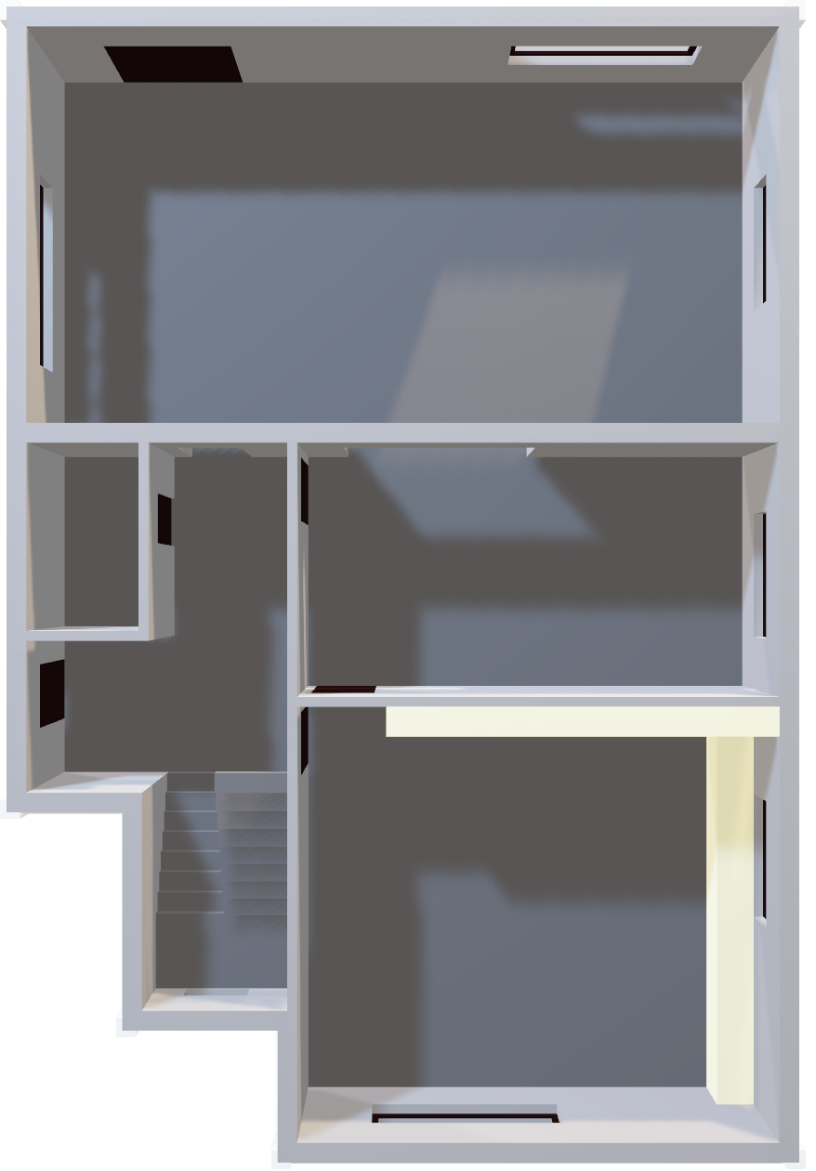

Feature Importances On CatBoost
Roof
Overall Quality, incorporating the latest technology of a home, is by far the most important feature for homebuyers.
Garage Space has also played an integral role for many.
One must not forget about Lot Area and Total Rooms.
Expansive Full Baths most certainly has its place on the list.
3rd Floor

Slide 16
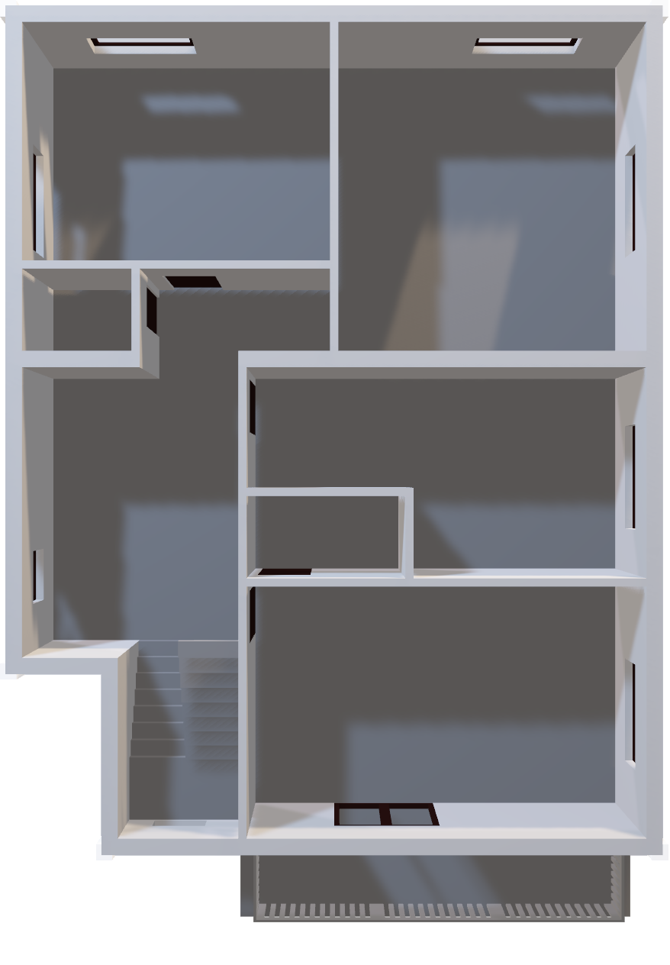
Cross Validation
Roof
Boasting three great sized bedrooms, the first with double doors leading to a balcony, and the others offering large windows to benefit from wonderful natural light.
The master ensuite bathroom provides bathtub and separate shower unit and is furnished to the highest of your personalized specifications.
The spacious 2.5 car garage epoxy floors are heated for the cold months.
This home sits on ¼ of an acre of tree lined picturesque beauty

